Slide 1

EXCEL
FILTER

Slide 2
INTRODUCTION
The FILTER function in Excel is used to return specific data from a range based on one or more conditions. It helps extract relevant data dynamically without manually sorting or searching.
Can be used in Fraud Prevention & Detection Technologies to;
Identifying Malicious IPs Quickly
Analyzing Fraudulent Transactions
Tracking Phishing Attacks
Real-Time Monitoring & Incident Response

Slide 3
Syntax of FILTER
=FILTER(array, include, [if_empty])
array → The range of data you want to filter.
include → The condition(s) used to filter the data.
if_empty (optional) → The value to return if no data matches the condition.

Slide 4
USAGE
Filter Based on a Single Condition
=FILTER(A4:E13,C4:C13="High","Invalid Severity Level")
This will return only rows where Threat Level (column C) is "High“
Filter Based on Multiple Conditions
=FILTER(A4:E13, (B4:B13="Malicious") * (C4:C13="High"), "Invalid Entry")
The * acts as AND logic, meaning both conditions must be met.
Filter Data Dynamically
=FILTER(A4:E13,C4:C13=B15,"Invalid Risk Level")
This will update results automatically as the value in G1 changes.

Slide 5
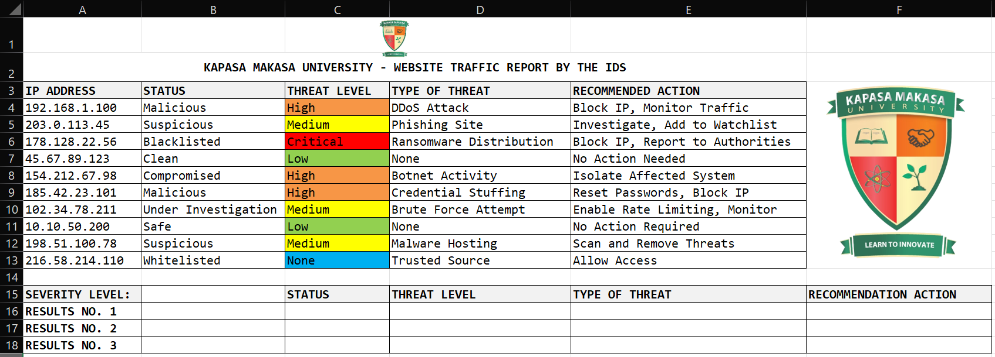
APPLICATION

Slide 6
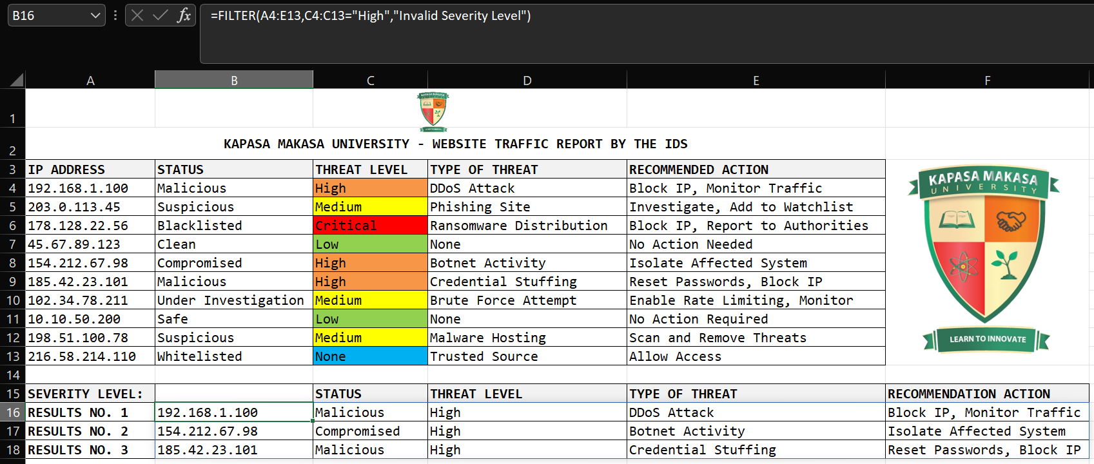
FILTER BASED ON SINGLE CONDITION
In cell B16 (Formula Bar) Enter: =FILTER(A4:E13,C4:C13="High","Invalid Severity Level")

Slide 7
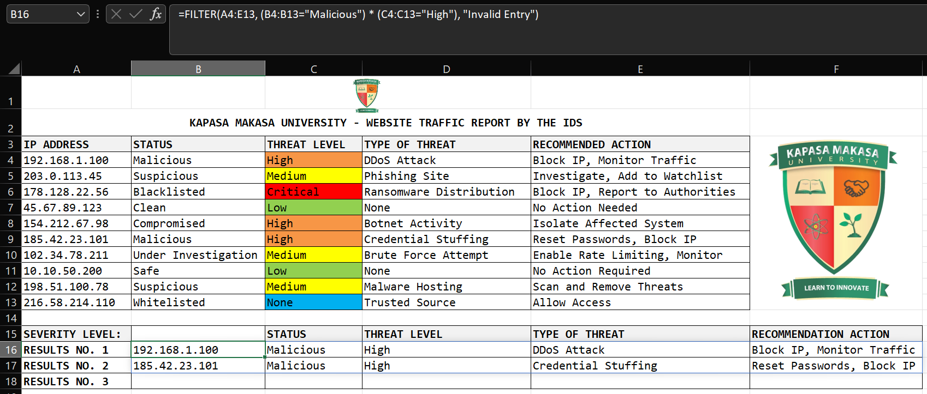
Filter Based on Multiple Conditions
In cell B16 (Formula Bar) Enter: =FILTER(A4:E13, (B4:B13="Malicious") * (C4:C13="High"), "Invalid Entry")

Slide 8
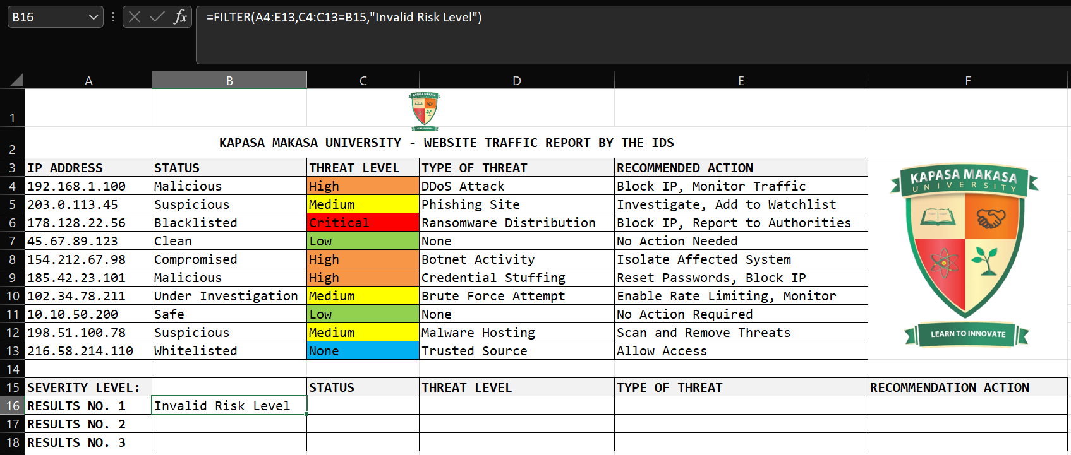
Filter Data Dynamically
In cell B16 (Formula Bar) Enter: =FILTER(A4:E13,C4:C13=B15,"Invalid Risk Level")

Slide 9
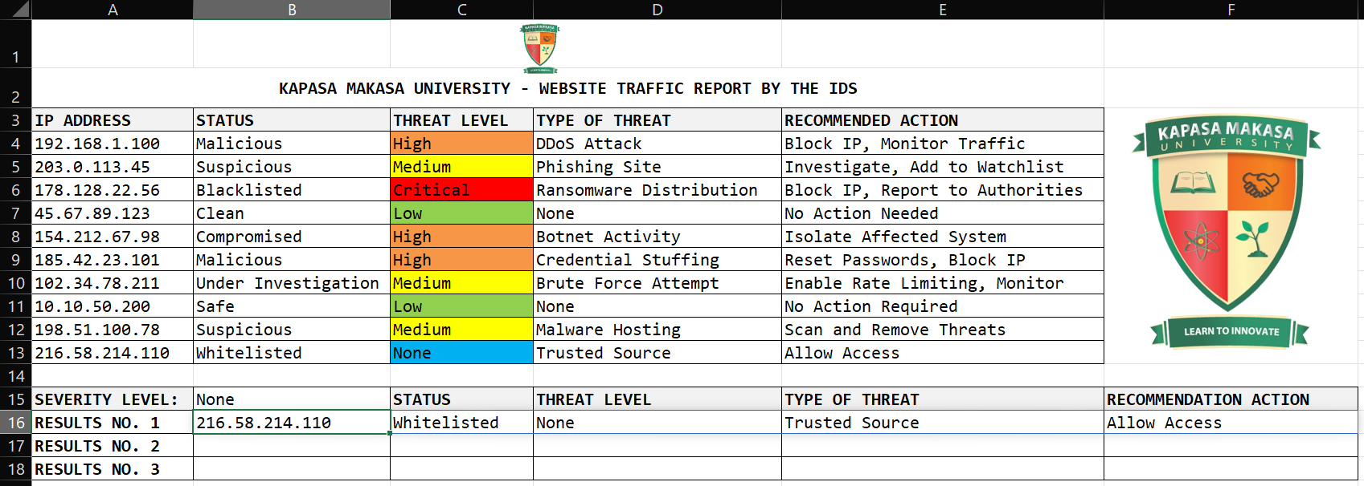
Filter Data Dynamically (Continues…)
Type “None” in cell B15 (Formula Bar) and press Enter.

Slide 10
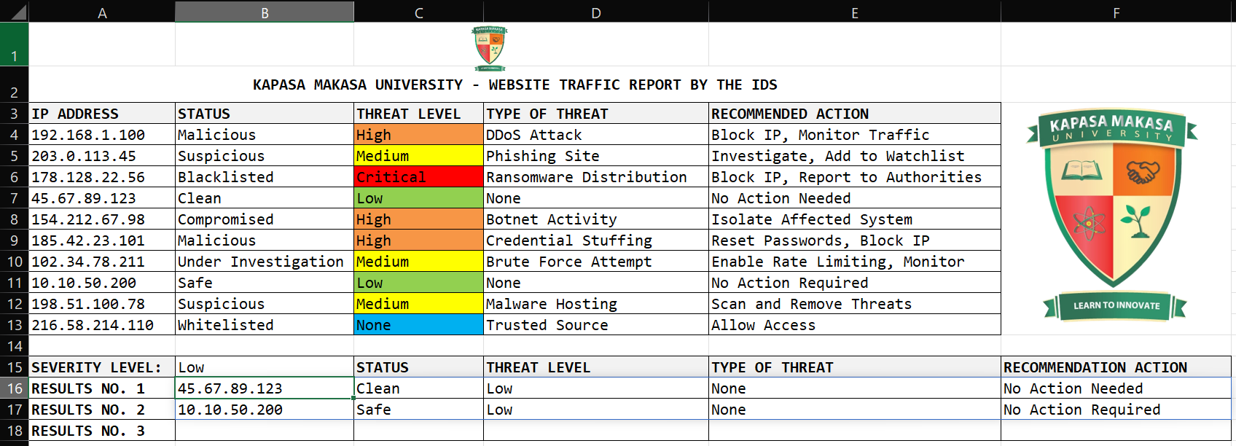
Filter Data Dynamically (Continues…)
Type “Low” in cell B15 (Formula Bar) and press Enter.

Slide 11
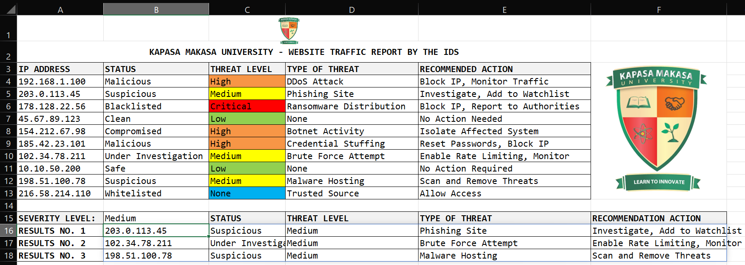
Filter Data Dynamically (Continues…)
Type “Medium” in cell B15 (Formula Bar) and press Enter.

Slide 12
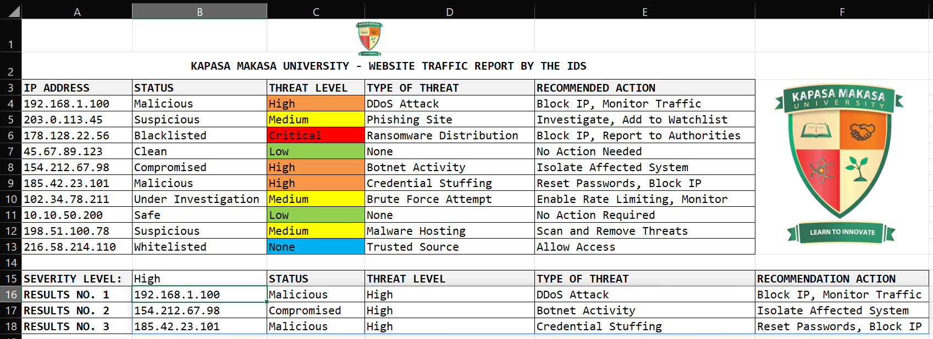
Filter Data Dynamically (Continues…)
Type “High” in cell B15 (Formula Bar) and press Enter.

Slide 13
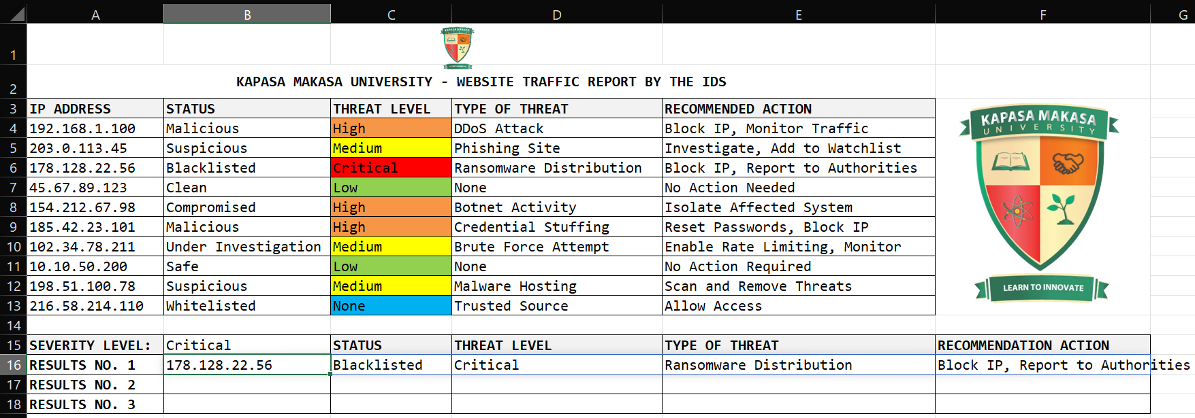
Filter Data Dynamically (Continues…)
Type “Critical” in cell B15 (Formula Bar) and press Enter.

Slide 14
ICT SOCIETY | EXCEL SLIDES
PREPARED BY JAMES SOKO

